Slide 1

Tiny oneM2M Server Developer guide
Jieun Lee (love9ly@gmail.com, love9ly@sju.ac.kr)
2022.05.17

Slide 2
Outline
Resource and Call Flows
HTTP Implementation Example
Reference

Slide 3
Resource and Call Flows

Slide 4
Resource Structure
Resource tree so far (abstract ver.)
AEs have containers of ‘status’
containers have data instances
CSE <CSEBase>
Sensor <AE>
Status <container>
<contentInstance>

Slide 5



APIs to try
AE registration
Resource discovery
Data resource creation
Sensor
(AE)
App
(AE)
G/W Platform
(CSE)

Slide 6
Call Flows
Registration
Devices and user app (AE) registers to the platform (CSE)
Sensor1
(AE)
Server
(CSE)
user app
(AE)
<AE> create request
<AE> create request

Slide 7
Call Flows
Initial resource creation
<container> and <contentInstance> resources
Sensor1
(AE)
Server
(CSE)
user app
(AE)
<container>, <contentInstance>
create request

Slide 8
Call Flows
Target container discovery
Sensor1
(AE)
Server
(CSE)
user app
(AE)
discovery request for sensor control
<container> create request

Slide 9
Call Flows
Resource tree so far (abstract ver.)
bulbs have containers of ‘status’
containers have data instances
CSE <CSEBase>
Sensor1 <AE>
status <container>
cin1 <contentInstance>
userApp <AE>
control <container>

Slide 10
Call Flows
Single switch on/off
Sensor1
(AE)
Server
(CSE)
user app
(AE)
<contentInstance> create request

Slide 11
Implementation

Slide 12
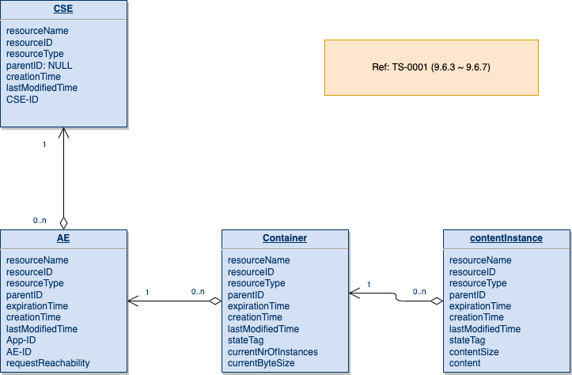
Resource (mandatory only)

Slide 13
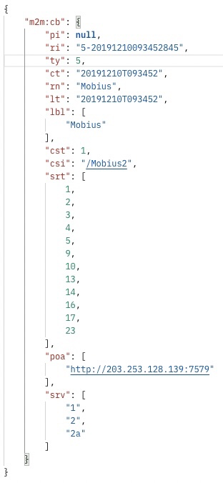
CSE Discovery
Discover a <CSE> resource
Note that we use HTTP binding in this session
HTTP response
HTTP request
oneM2M primitive
GET /Mobius HTTP/1.1
Host: | localhost:7579
X-M2M-Origin: | TAE
X-M2M-RI: | 1234
Accept: | application/json
{
"to": "Mobius",
"fr": ”TAE",
"op": 2,
"rqi": "1234"
}
protocol binding

Slide 14
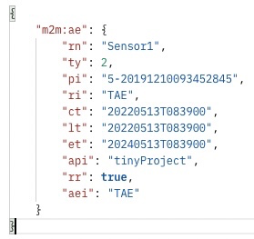
AE Registration
<AE> resource creation with mandatory attributes
Note that we use HTTP binding in this session
HTTP request
oneM2M primitive
POST /Mobius HTTP/1.1
Host: | localhost:7579
X-M2M-Origin: | TAE
X-M2M-RI: | 1234
Content-Type: | application/json; ty=2
Accept: | application/json
HTTP response
{
"to": "Mobius",
"fr": ”TAE",
"op": 1,
"rqi": "1234",
"pc": {
"m2m:ae": {
"rn": ”tiny_ae_test",
"api": " tinyProject",
"rr": true
}
}
}
protocol binding
{
"m2m:ae": {
"rn": ”Sensor1",
"api": ”tinyProject",
"rr": true
}
}

Slide 15
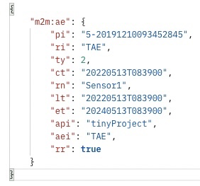
AE Discovery
Discover a <AE> resource
Note that we use HTTP binding in this session
HTTP response
HTTP request
oneM2M primitive
GET /Mobius/Sensor1 HTTP/1.1
Host: | localhost:7579
X-M2M-Origin: | TAE
X-M2M-RI: | 1234
Accept: | application/json
{
"to": "Mobius/Sensor1",
"fr": ”TAE",
"op": 2,
"rqi": "1234"
}
protocol binding

Slide 16
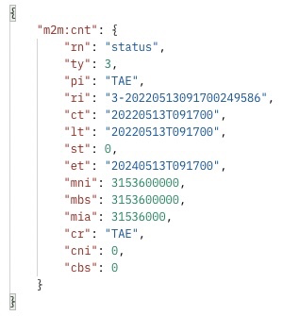
CNT Resource Creation
<container> resources creation for sensing and control
Iterate this for two light bulbs ‘status’ containers
HTTP request
HTTP response
oneM2M primitive
POST /Mobius/Sensor1 HTTP/1.1
Host: | localhost:7579
X-M2M-Origin: | TAE
X-M2M-RI: | 1234
Content-Type: | application/json; ty=3
Accept: | application/json
{
"to": "Mobius/Sensor1",
"fr": ”TAE",
"op": 1,
"rqi": "1234",
"pc": {
"m2m:cnt": {
"rn": "status"
}
}
}
protocol binding
{
"m2m:cnt": {
"rn": "status"
}
}

Slide 17
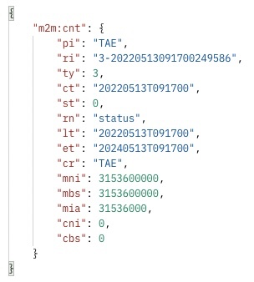
CNT Discovery
Discover a <container> resource
Note that we use HTTP binding in this session
HTTP response
HTTP request
oneM2M primitive
GET /Mobius/Sensor1/status HTTP/1.1
Host: | localhost:7579
X-M2M-Origin: | TAE
X-M2M-RI: | 1234
Accept: | application/json
{
"to": "Mobius/Sensor1/status",
"fr": ”TAE",
"op": 2,
"rqi": "1234"
}
protocol binding

Slide 18
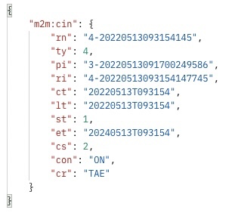
CIN Resource Creation
<contentInstance> resources creation for initial status
HTTP request
HTTP response
oneM2M primitive
POST /Mobius/Sensor1/status HTTP/1.1
Host: | localhost:7579
X-M2M-Origin: | TAE
X-M2M-RI: | 1234
Content-Type: | application/json; ty=4
Accept: | application/json
{
"to": "Mobius/Sensor1/status",
"fr": ”TAE",
"op": 1,
"rqi": "1234",
"pc": {
"m2m:cin": {
"con": "ON"
}
}
}
protocol binding
{
"m2m:cin": {
"con": "ON"
}
}

Slide 19
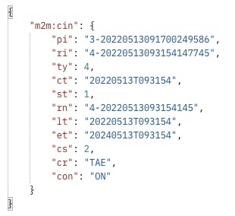
CIN Discovery
Discover a <contentInstance> resource
Note that we use HTTP binding in this session
HTTP response
HTTP request
oneM2M primitive
GET /Mobius/Sensor1/status/latest HTTP/1.1
Host: | localhost:7579
X-M2M-Origin: | TAE
X-M2M-RI: | 1234
Accept: | application/json
{
"to": "Mobius/Sensor1/status/latest",
"fr": ”TAE",
"op": 2,
"rqi": "1234"
}
protocol binding

Slide 20
Reference
oneM2M Short Name Finder
https://github.com/IoTKETI/oneM2M_shortname_finder
HTTP Functions
TS-0004 mandatory only (e-mail)
Postman Collections
Tiny oneM2M Server.postman_collection.json (e-mail)
oneM2M tutorial (youtube)
oneM2M API (https://www.youtube.com/watch?v=pREoTt8585c&list=PL-ZgPBFZJJmmqbv4PvfCoLNVz40nKsGzZ&index=4&t=10s)
oneM2M 어플리케이션 개발 가이드 (https://www.youtube.com/watch?v=VzPleRkUJr0&list=PL-ZgPBFZJJmmqbv4PvfCoLNVz40nKsGzZ&index=8&t=1031s)

